Slide 1
MEMORY What Is Memory?
Memory: an active system that receives information from the senses, organizes and alters that information as it stores it away, and then retrieves the information from storage
Three Processes of Memory
Processes of Memory
Encoding: set of mental operations that people perform on sensory information to convert that information into a form usable in the brain’s storage systems
Storage: holding onto information for period of time
Retrieval: getting information in storage into a form that can be used

Slide 2
Models of Memory
Information-processing model: assumes that the processing of information for memory storage is similar to the way a computer processes memory—in a series of three stages
Parallel distributed processing (PDP) model: memory processes are proposed to take place at the same time over a large network of neural connections
EG :-understanding of the sentence.
Levels-of-processing model: assumes that information that is more “deeply processed”—or processed according to its meaning, rather than just the sound or physical characteristics of the word or words—will be remembered more efficiently and for a longer period of time
EG :- remembering a new acquaintance's name.

Slide 3
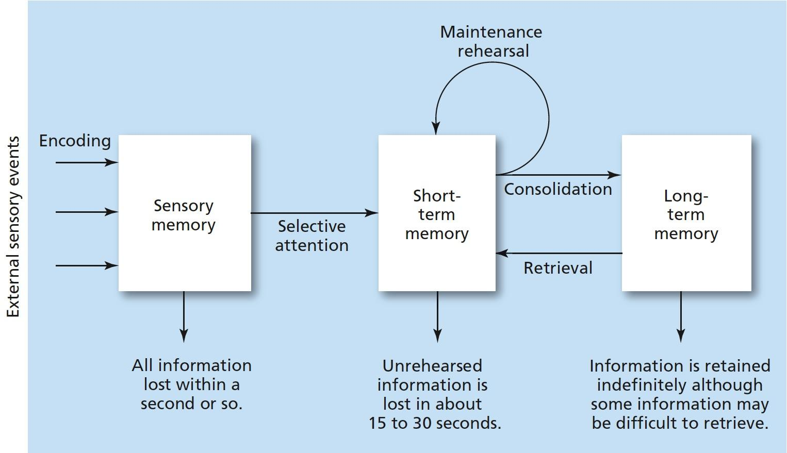
Figure 6.1 Three-Stage Process of Memory
Information enters through the sensory system, briefly registering in sensory memory. Selective attention filters the information into short-term memory, where it is held while attention (rehearsal) continues. If the information receives enough rehearsal (maintenance or elaborative), it will enter and be stored in long-term memory.

Slide 4
Sensory Memory: Why Do People Do Double Takes?
Sensory memory: the very first stage of memory
Point at which information enters the nervous system through the sensory systems
Raw information from the senses is held for a very brief period of time
TYPES OF SENSORY MEMORY
Iconic memory: temporary storage of visual memory
Capacity: everything that can be seen at one time
Duration: information that has just entered iconic memory will be pushed out very quickly by new information, a process called masking
Eidetic imagery: the (rare) ability to access a visual memory for thirty seconds or more
Echoic memory: temporary storage of auditory information
Capacity: limited to what can be heard at any one moment; smaller than the capacity of iconic memory
Duration: lasts longer than iconic; about two to four seconds

Slide 5
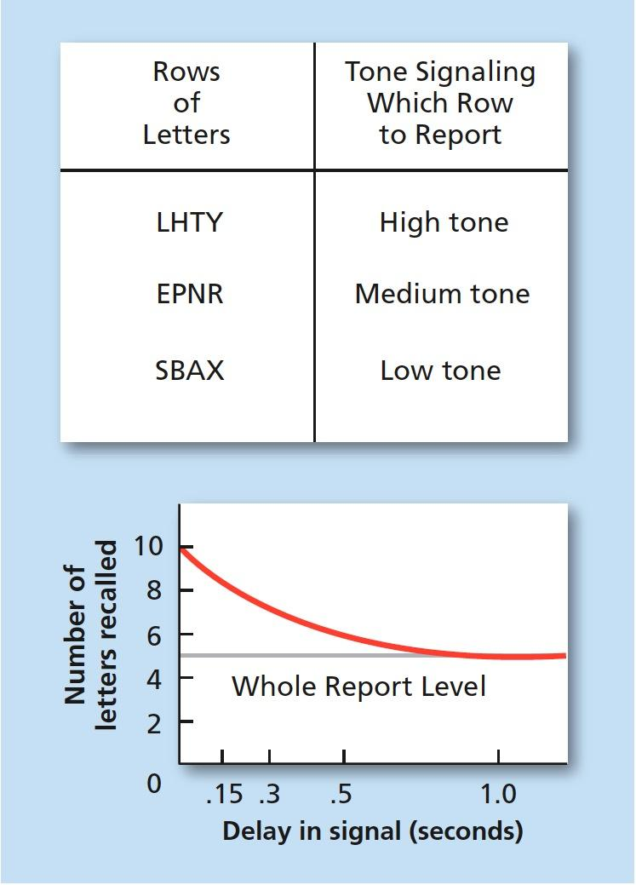
Figure 6.2 Iconic Memory Test
Sample grid of letters for Sperling’s test of iconic memory. To determine if the entire grid existed in iconic memory, Sperling sounded a tone associated with each row after the grid’s presentation. Participants were able to recall the letters in the row for which they heard the tone. The graph shows the decrease in the number of letters recalled as the delay in presenting the tone increased.

Slide 6
Short-Term Memory
Short-term memory (STM; working memory): the memory system in which information is held for brief periods of time while being used
Selective attention: ability to focus on only one stimulus from among all sensory input
Digit-span test: a series of numbers is read to subjects who are then asked to recall the numbers in order
Conclusion: capacity of STM is about seven items or pieces of information, plus or minus two items—or from five to nine bits of information.
Magical number = 7
STM lasts from about twelve to thirty seconds without rehearsal
STM is susceptible to interference
e.g., if counting is interrupted, one will have to start over

Slide 7
Short-Term Memory
Chunking: bits of information are combined into meaningful units, or chunks, so that more information can be held in STM
Maintenance rehearsal: saying bits of information to be remembered over and over in one’s head in order to maintain it in short-term memory
STMs tend to be encoded in auditory form

Slide 8
Long-Term Memory
Long-term memory (LTM): the memory system into which all the information is placed to be kept permanently
Elaborative rehearsal: a method of transferring information from STM into LTM by making that information meaningful in some way
Nondeclarative (implicit) memory: This is an unconscious memory that we use without thinking,
Example:- muscle memory for playing an instrument or riding a bike
These memories are not conscious, but their existence is implied because they affect conscious behavior
Includes emotional associations, habits, and simple conditioned reflexes
Anterograde amnesia: loss of memory from the point of injury or trauma forward, or the inability to form new long-term memories
HIPPOCAMPUS

Slide 9
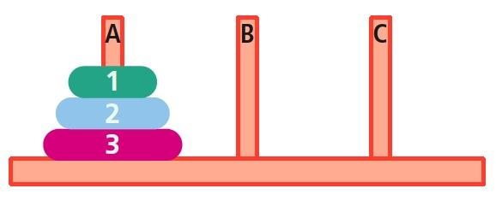
Figure: Tower of Hanoi
The Tower of Hanoi is a puzzle that is solved in a series of steps by moving one disk at a time. The goal is to move all of the disks from peg A to peg C; the rules are that a larger disk can not be moved on top of a smaller one and a disk can not be moved if there are other disks on top of it. Amnesia patients were able to learn the procedure for solving the puzzle but could not remember that they knew how to solve it.

Slide 10
Long-Term Memory
Declarative (explicit) memory: This involves the conscious recall of information such as facts, events, and personal experiences.
example :-your favorite childhood memory. If you are able to remember a specific event or experience from your past, such as a family vacation or a birthday celebration
Types of Declarative Memory
Semantic memory: declarative memory containing general knowledge
Knowledge of language, information learned in formal education eg:- A translator knows the language
Episodic memory: declarative memory containing personal information not readily available to others
remembering your high school graduation day. You might recall details such as what you were wearing, who you were with, the location of the ceremony
Semantic network model: assumes that information is stored in the brain in a connected fashion

Slide 11
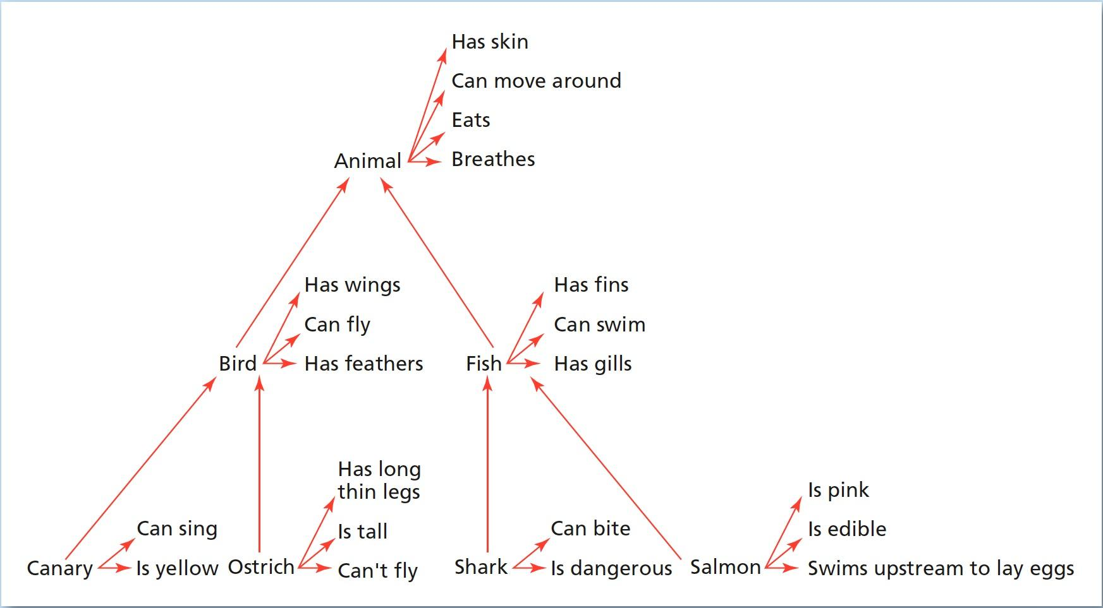
Figure 6.5 An Example of a Semantic Network
In the semantic network model of memory, concepts that are related in meaning are thought to be stored physically near each other in the brain. In this example, canary and ostrich are stored near the concept node for “bird,” whereas shark and salmon are stored near “fish.” But the fact that a canary is yellow is stored directly with that concept.

Slide 12
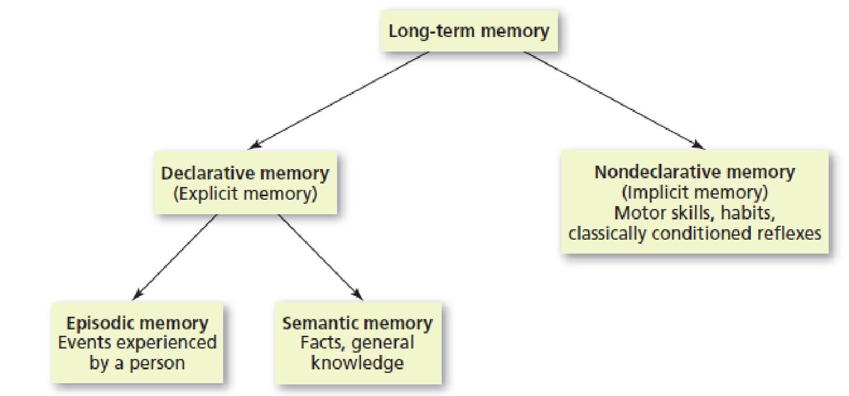
Figure: Types of Long-Term Memories
Long-term memory can be divided into declarative memories, which are factual and typically conscious (explicit) memories, and nondeclarative memories, which are skills, habits, and conditioned responses that are typically unconscious (implicit). Declarative memories are further divided into episodic memories (personal experiences) and semantic memories (general knowledge).

Slide 13
Retrieval Cues
Retrieval cue:are pieces of information that help trigger or stimulate the retrieval of stored memories. These cues serve as a reminder or hint
Example :- Recalling a name by visual a person’s face
Priming :-process by which a previous experience or exposure to a particular stimulus affects a person's perception, behavior, or memory for a subsequent stimulus.
Encoding specificity: Encoding specificity is a principle in psychology that suggests that the effectiveness of memory retrieval depends on the match between the conditions present during learning (encoding) and the conditions present during retrieval
State-dependent learning: memories formed during a particular physiological or psychological state will be easier to recall while in a similar state
model of memory padhna hai

Slide 14
Recall and Recognition
Recall: a cognitive process in which we retrieve information from memory with very few external cues
Retrieval failure: recall has failed (at least temporarily)
Tip of the tongue (TOT) phenomenon

Slide 15
Recall and Recognition
Serial position effect: information at beginning and end of a body of information more accurately remembered than information in middle
Primacy effect: tendency to remember information at beginning of a body of information better than what follows
Recency effect: tendency to remember information at end of a body of information better than the information ahead of it

Slide 16
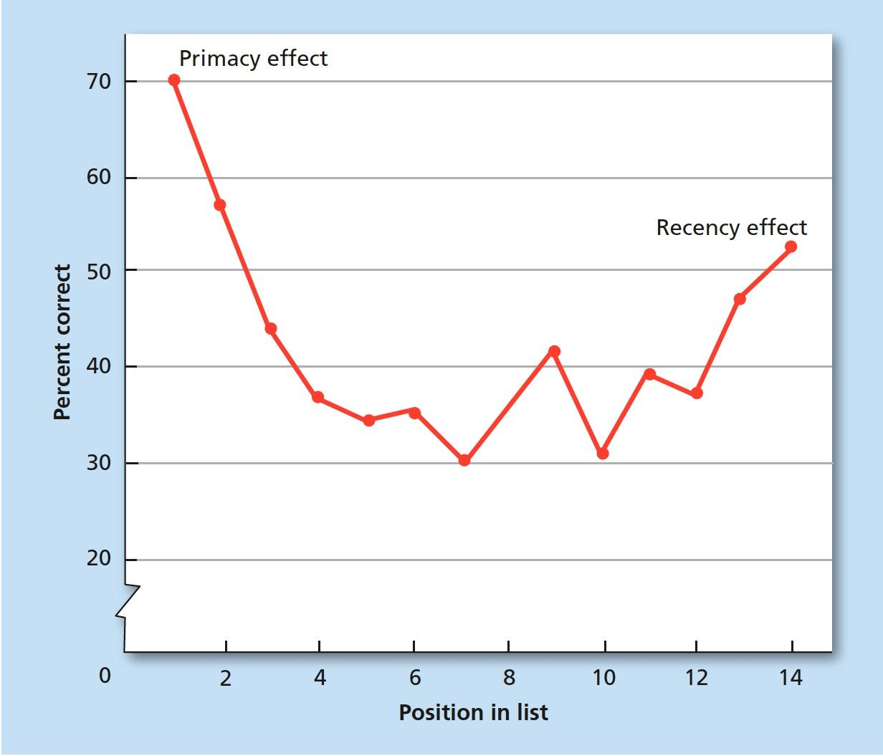
Figure 6.6 Serial Position Effect
In the serial position effect, information at the beginning of a list will be recalled at a higher rate than information in the middle of the list (primacy effect), because the beginning information receives more rehearsal and may enter LTM. Information at the end of a list is also retrieved at a higher rate (recency effect), because the end of the list is still in STM, with no information coming after it to interfere with retrieval.

Slide 17
Recall and Recognition
Recognition: the ability to identify or acknowledge something that has been encountered befor
False positive: error of recognition in which people think that they recognize a stimulus that is not actually in memory
Elizabeth Loftus and Eyewitnesses
Showed that what people see and hear about an event afterwards can affect accuracy of their memories
Demonstrated that eyewitness testimony is not always reliable

Slide 18
Automatic Encoding: Flashbulb Memories
how some memories are automatically encoded into long-term memory?
Automatic encoding: tendency of certain kinds of information to enter long-term memory with little or no effortful encoding
Flashbulb memories: automatic encoding that occurs because an unexpected event has strong emotional associations for person remembering it

Slide 19
The Biological Bases of Memory
Consolidation: changes that take place in the structure and functioning of neurons when a memory is formed
Long-term potentiation: changes in number and sensitivity of receptor sites/synapses through repeated stimulation
Hippocampus: area of brain responsible for the formation of ltms

Slide 20
When Memory Fails: Organic Amnesia
Retrograde amnesia: loss of memory from the point of some injury or trauma backwards, or loss of memory for the past
Anterograde amnesia: loss of memory from the point of injury or trauma forward, or the inability to form new long-term memories
Senile dementia
Case of H.M.

Slide 21
When Memory Fails: Organic Amnesia
Risk factors
High cholesterol
High blood pressure
Smoking
Obesity
Type II diabetes
Lack of exercise
Infantile amnesia: the inability to retrieve memories from much before age three
Autobiographical memory: the memory for events and facts related to one’s personal life story (usually after age three)
Alzheimer’s Disease
5.3 million cases in U.S.
Most common type of dementia in adults and elderly
Primarily anterograde amnesia
Various drugs to slow or stop progression, but no cure

Slide 22
Health and Memory
Sleep important in forming memories
Memory consolidation
Sleep deprivation interferes with hippocampal functioning
Even brief exercise good for memory
Fish is brain food?
Omega-3 fatty acid called dha helps memory cells communicate

